Slide 1
Instantaneous Relative Positioning for Multiple GPS Receivers
Lydia Drabsch
Notes:
Those terms can mean different things in different situations so I’m going to break it down.

Slide 2
Breakdown
Instantaneous - one timestep from each receiver
Relative position - 3D position vector from a reference receiver in its local frame
Multiple - two or more receivers in the system
GPS Receivers - only GPS signals

Slide 3
Motivation
Localisation is a fundamental part of any mobile system
For outdoor systems, GPS is the common solution
GPS finds the absolute position in the ECEF frame
Civilian use of normal GPS is typically accurate to 5m [1]
Relative position is more accurate as it removes some systemic errors
For systems in the same geographical region, relative positioning is sufficient
[1] http://www.gps.gov/systems/gps/performance/accuracy/
Notes:
Required for mapping path planning, feedback for control systems,
Explain where that error comes from later
Due to this error in absolute position, using relative position

Slide 4
Basis of GPS
Triangulation
Measures the distance from multiple known locations to the receiver
Solve for the intersection
Notes:
The basis of GPS operates on triangulation principle
is that it measures the distance from known locations (satellites positions) and solves for the intersection on the spheres

Slide 5

How GPS Measures Distance
In order to measure distance, an encoded radio signal is repeatedly sent from the satellite at fixed points in time
The receiver measures the transmission time and as we know the speed of light, the distance is calculated
Notes:
In order to measure distance, an encoded radio signal is repeatedly sent from the satellite at fixed points in time. The receiver measures the transmission time and as we know the speed of light, the distance is calculated .
Explain the word epoch

Slide 6
Errors in time
There is error in the transmission time of the signal
Error of 1 microsecond is 300m at the speed of light
Satellite correlated errors: Ionosphere, Troposphere, Clock bias, ephemeris error
Receiver correlated errors: clock bias, phase wind up
Uncorrelated errors: multipath
Satellites have atomic clocks – nanosecond accuracy
Low cost GPS receivers – microsecond accuracy
The range calculated with imprecise time is called the pseudorange
Notes:
Clock bias -

Slide 7
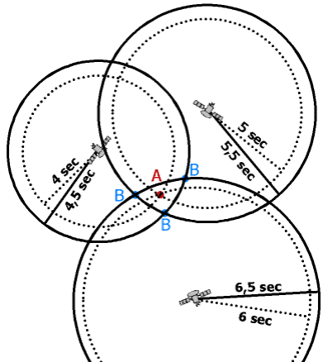
Solving for Receiver Clock bias
The pseudorange is adjusted proportionally for all satellites to solve for the clock bias
Clock bias is a fourth variable to solve for
Minimum of four satellites needed
Image source: http://www.kowoma.de/en/gps/positioning.htm
Notes:
HOW GPS WORKS: Triangulation of 4 satellites – explain time error so need 4
Solve by NLLS here? – do you need to explain this? –
- Solves for receiver clockbias

Slide 8
Aims
Sub-meter accuracy for the relative position
Minimal calibration
No external hardware
Low cost receivers
Computationally simpler
Notes:
Different way of calculating relative position with minimal calibration, no external hardware setup, cheaper, computationally simpler

Slide 9
Removing Error
The satellite correlated errors are cancelled out by taking the difference in pseudorange between two receivers from a single satellite
The satellite is so far away that for receivers in the same geographical region, the direction vectors to the satellite are parallel [1]
[1] Hedgecock, W., Maroti, M., Sallai, J., Volgyesi, P., & Ledeczi, A. (2013, June). High-accuracy differential tracking of low-cost GPS receivers. In Proceeding of the 11th annual international conference on Mobile systems, applications, and services (pp. 221-234). ACM.
Notes:
this assumption has been made previously

Slide 10
Synchronising time
t2
t1
Receivers sample signals at 1Hz during which time the satellite could have moved up to 4km
Receivers in the system are unlikely to take readings at the exact same time
The extra distance travelled by the radio signal is in the vacuum of space, no delays
The change in pseudorange is calculated along the reference direction vector to reduce the error from asynchronous sampling times
Has some error due to receiver clock bias
Notes:
Because multiple receivers may not take data at exactly the same time,

Slide 11
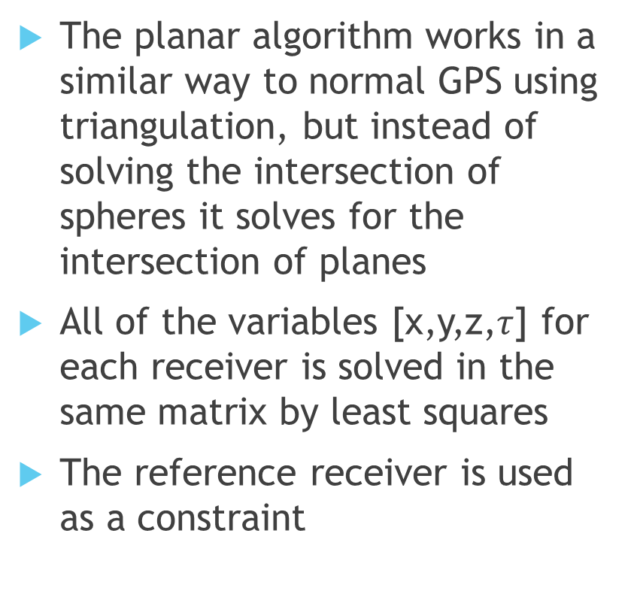

Planar Solution
The planar algorithm works in a similar way to normal GPS using triangulation, but instead of solving the intersection of spheres it solves for the intersection of planes
All of the variables [x,y,z,$τ$] for each receiver is solved in the same matrix by least squares
The reference receiver is used as a constraint
$$A^{1}x_{r}+B^{1}y_{r}+C^{1}z_{r}+τ_{r}−τ_{0}=D_{0r}^{1}$$
Notes:
Using the distances previously calculated to create sets of planes, and solve for all variables at once
Include the location of alpha as a constraint
The clock bias for the reference node is used as a constraints

Slide 12
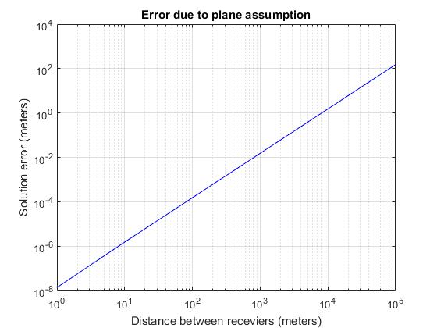
Error Analysis
Logarithmic relationship for the distance between two receivers and the error in the relative position
The plane assumption has submeter inaccuracy for distances up to 10km

Slide 13
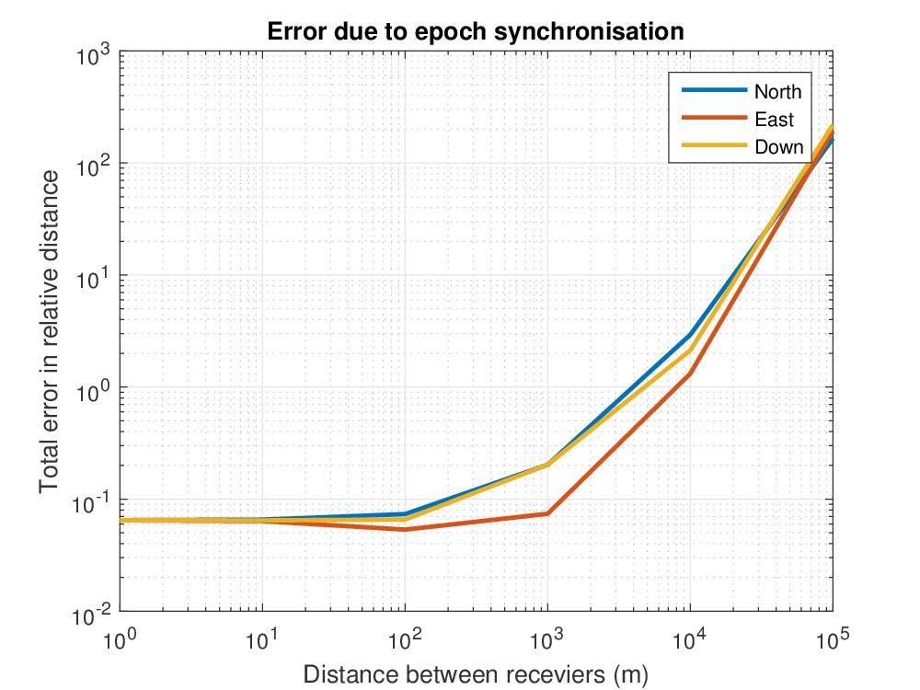
Error Analysis
Synchronising the receiver times did not remove all the error
As the distance increase between receivers, the assumption that the vectors are parallel breaks down

Slide 14
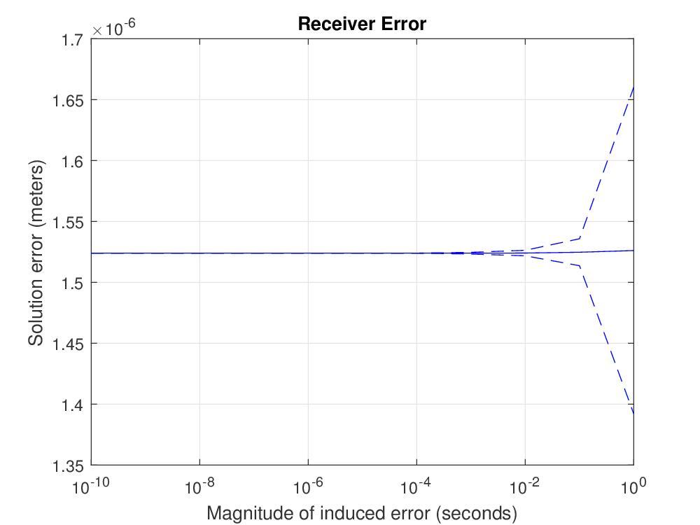
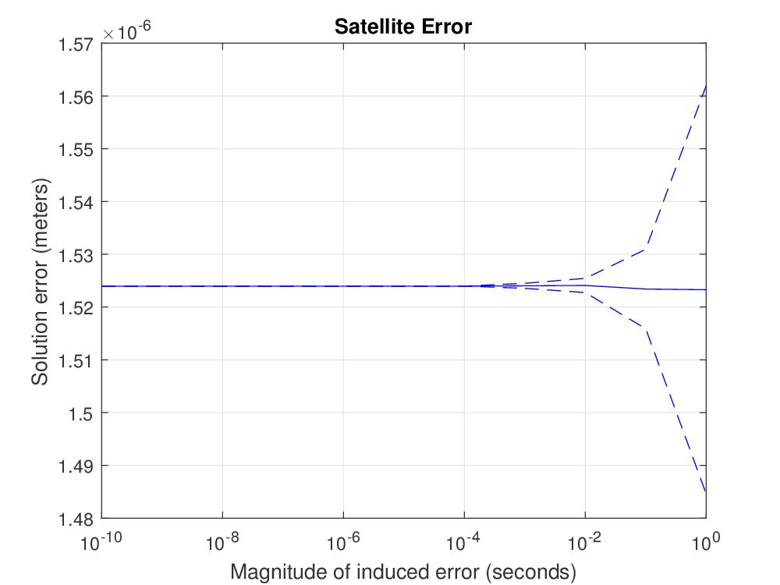
Correlated Errors
All correlated errors are reduced to micro-meter precision

Slide 15
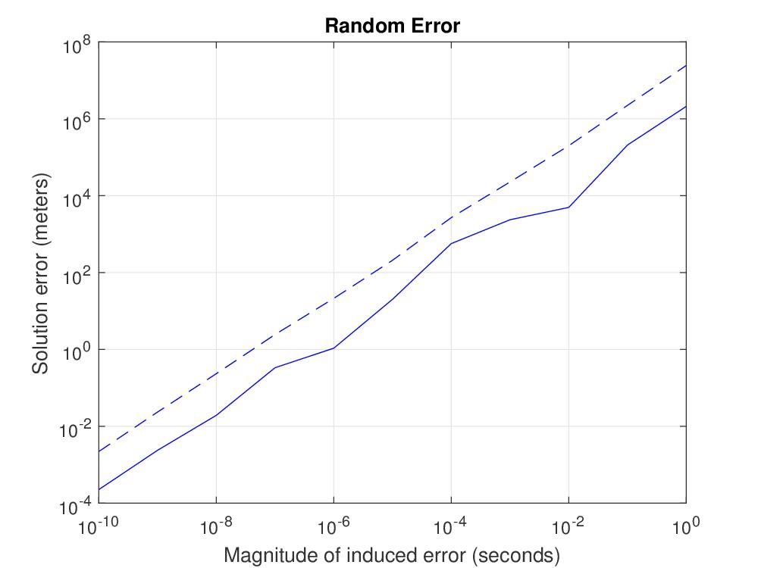
Random Error
Random errors are the most prevalent in the system
Typically about 10ns
Can be caused by electrical interference, relativistic clock correction, etc

Slide 16
Conclusion
All data was gathered using a simulation in Matlab
The simulation suggests that the planar solution with the associated assumptions generated a relative localisation with submeter accuracy
Future work would be to test the planar solution on hardware

